Slide 1
Industrial
Revolution
4.0
By: Ratha Ariyanayagam

Slide 2
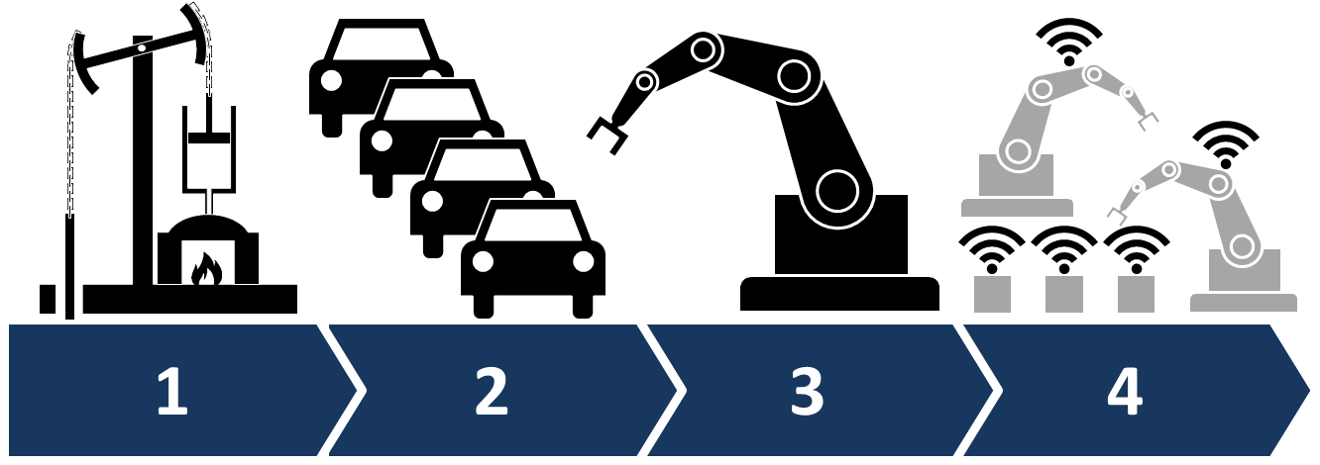
Introduction
The industry 4.0 is a device that is used to scan in QR code to display information about a machine and give it command.
our group had to make a scanner that will read in information for a QR code to do certain command like get the temperature reading of the device the light reading and other thing depending on the machine senses.

Slide 3
Budget
CanaKit Raspberry Pi 3 Ultimate Starter Kit - 32 GB Edition $141.73
Raspberry Pi Camera Module V2 - 8 Megapixel,1080p $64.47
-Mini Compact Portable Power Bank 10000mAh Ultra Slim Power Pack Mobile Phone Charger External LG Battery Dual USB Charger Compatible Universal High Speed Quick Charging iPhone, iPad, Samsung $34.42
Kuman SC5A 5"inch Resistive 800x480 HDMI TFT LCD Display Module with Touch panel USB Port and Touch pen for Raspberry Pi 3 2 Model B RPi 1 B B+ A A+ $59.99
CanaKit 2.5A Raspberry Pi Micro USB Power Supply / Adapter (UL Listed) $13.95
PCB part kit $30
Total of the two item is: $ 81.24 making the some total to be: $351.86

Slide 4
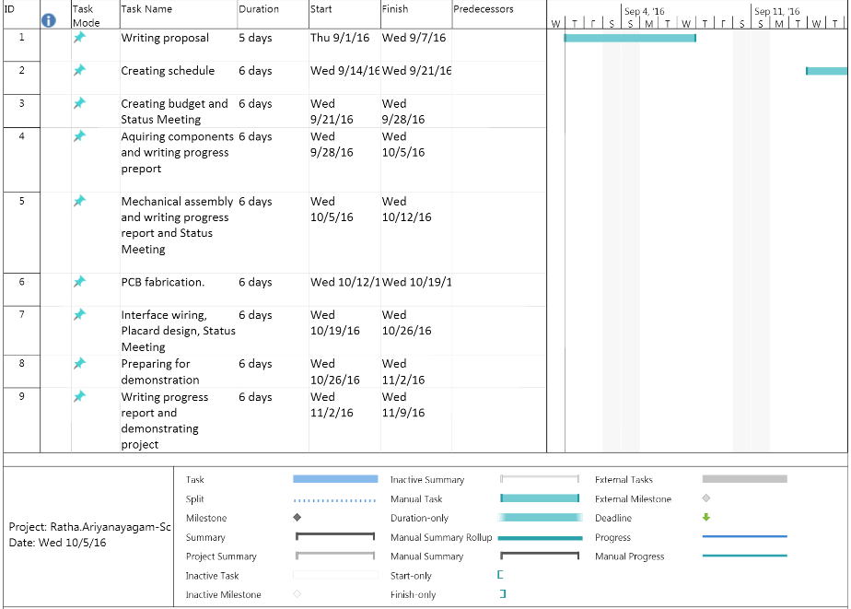
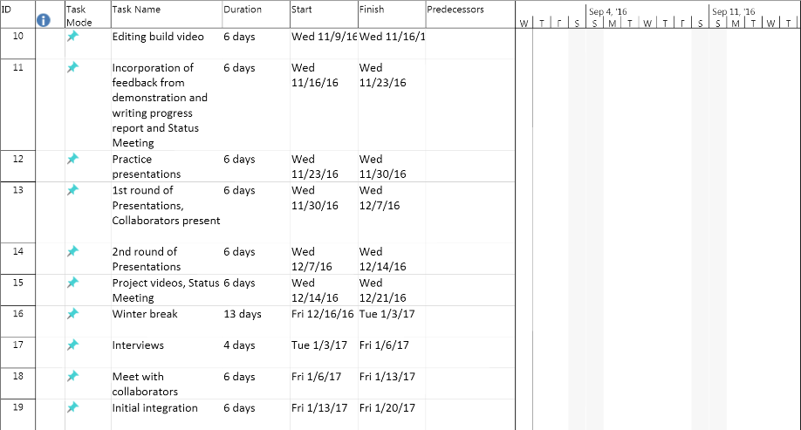
Schedule
What not done
- Database online
Connecting the database to get information from the
PCB and display it
What been done
QR code scanner work
PCB board work
When scan LED changes color

Slide 5

Build Video
To get the QR scanner to work go to these to websites:
https://technoobsite.wordpress.com/2016/02/02/raspberry-pi-barcode-scanner/
and to get the uv4l driver for the camera go to:
http://www.linux-projects.org/uv4l/installation/

Slide 6
Course Knowledge
Things I learn in his course
soldering
python coding
creating a circuit board (PCB board)
Thing I new before
Circuit building
if statement
while statement
database
PLC
SQL

